Slide 1
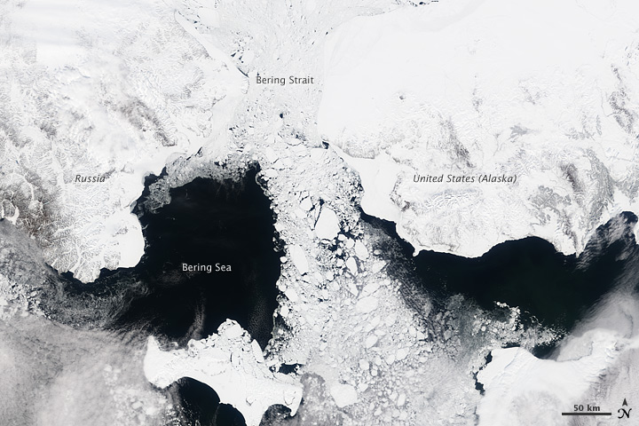
James Thorson, Cole Monnahan, Cecilia O’Leary
Bering
Strait
Russia
Alaska
Bering
Sea
A training workshop for the Vector Autoregressive Spatio-Temporal (VAST) model
NASA MODIS image by Jesse Allen
Notes:
MODIS image of the Bering Sea, Bering Strait and southern Arctic Ocean acquired 7 May 2000. Image generated from MODIS band 2 (0.85 µm) at 250 m spatial resolution. Detailed structure and leads in the ice pack are apparent. Ice flow from the Bering Strait southward to the Bering Sea is seen in great detail.
Physical land constriction of ice flow s +darkness = ice formation in the winter

Slide 2
VAST package and FishStats toolbox
Spatio-temporal model
Benefits of single approach
Include biological mechanism
Improved communication
Similar review standards and “burden of proof”
Stock Assessment
Habitat Assessment
Integrated ecosystem assessment
Climate Assessment

Slide 3
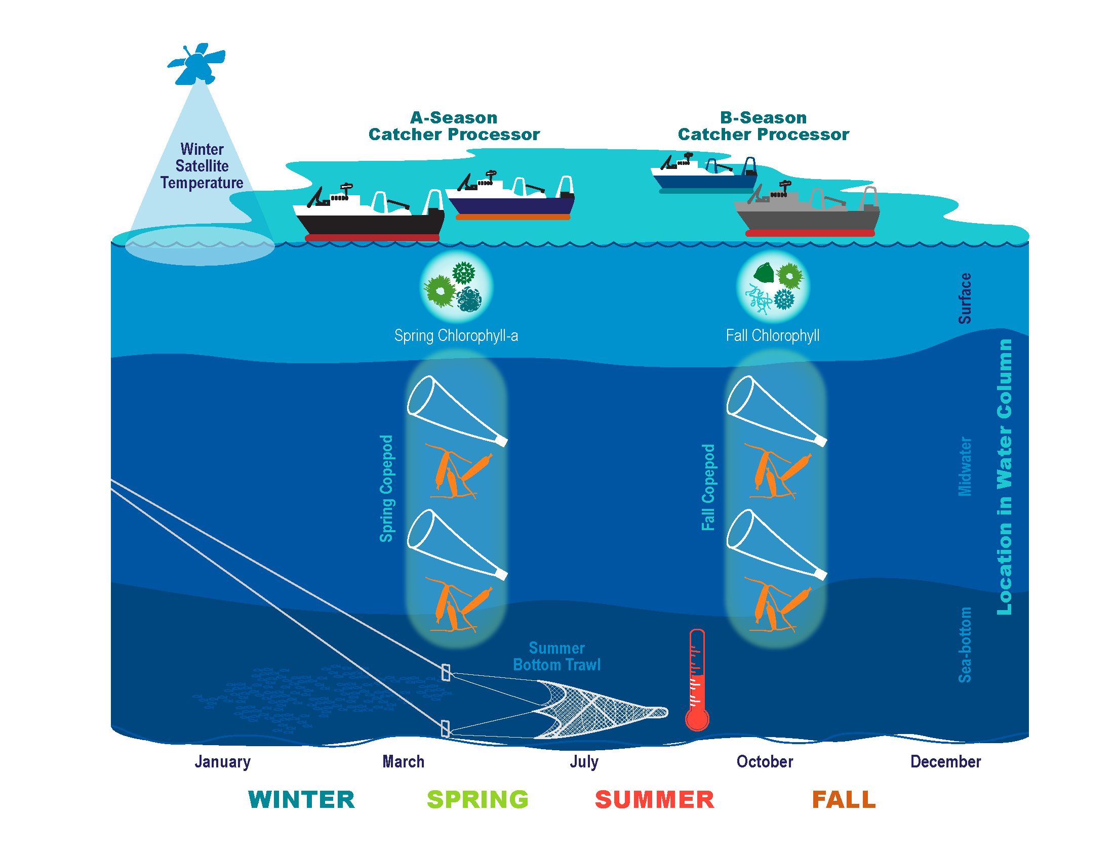
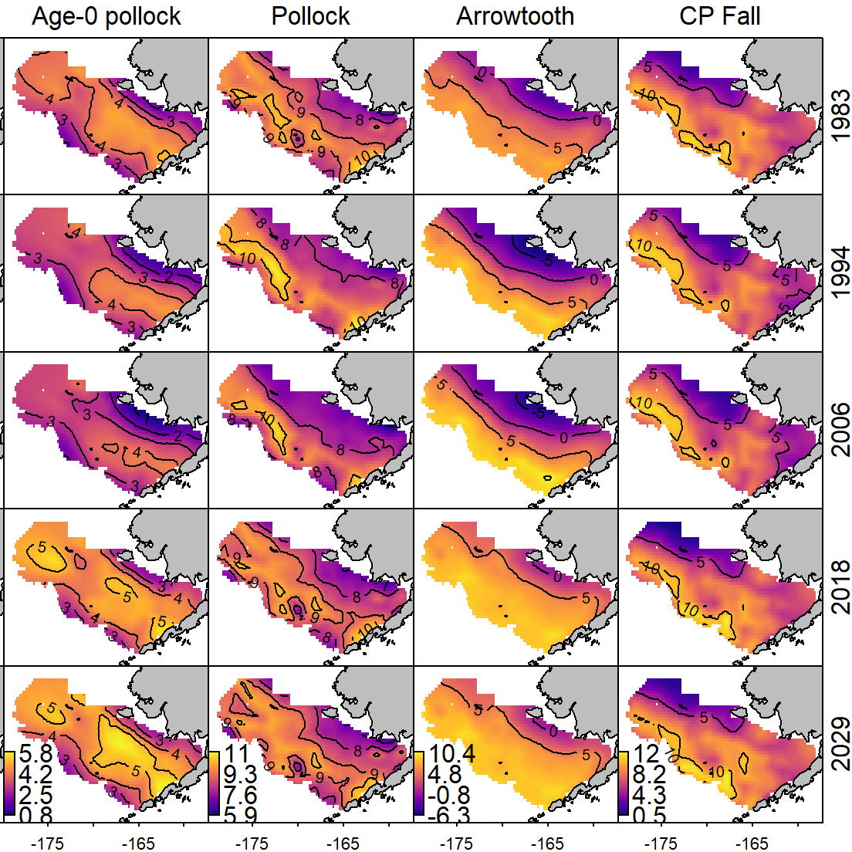
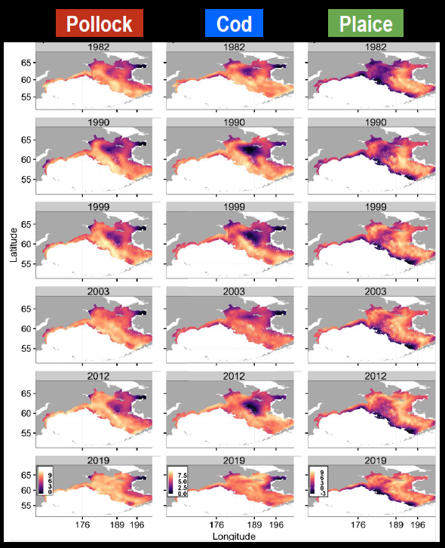
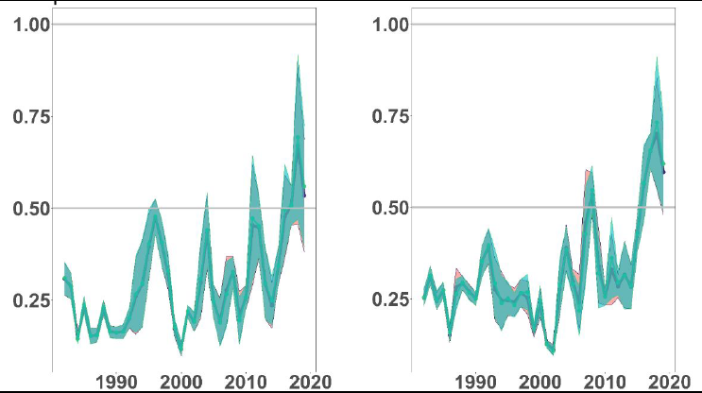
Multivariate spatio-temporal models
Whole of ecosystem synthesis: Eastern Bering Sea
Pollock Cod
Pollock Cod
International partnerships:
US and Russia
Proportion outside of eastern Bering Sea survey

Slide 4
Shown by Goodman et al. 2022 (https://doi.org/10.1111/ecog.06084, see Fig. 6 left panel)
Shown by Thorson et al. 2021 (https://doi.org/10.1111/ecog.05471, see Fig. 6, 3rd row)
Arrowtooth consumption of age-0 pollock
Predator/prey overlap
Age-0 pollock abundance
(northern middle domain)
Arrowtooth abundance
(northern middle domain)
Cold pool extent
Age-0 pollock abundance
(southern middle domain)
Arrowtooth abundance
(outer domain)
Notes:
Fitted a spatio-temporal model using VAST with (right) or without (left) ROMS reconstruction of bottom temperature as a log-linear and log-quadratic effect on two linear predictors in a delta model. Including temperature had little effect on predictions of density, although differences are perhaps noticeable in 2016.

Slide 5
Multiple roles for VAST in NMFS Science Pipeline
Stage | Description | Role for VAST | Example
1 | field planning and survey design | Optimize survey design | Oyafuso et al. 2021 ICESJMS
2 | survey coordination and implementation | Plan for survey disruptions | ICES WK-USER report on model-based evaluation
3 | synthesis of survey data to generate data products | Standardize data | Mod-Squad TOR as annual AFSC program
4 | use in stock, habitat, ecosystem, & climate assessment models | Improve efficiency and inference for NMFS core activities | VAST applications list
5 | discussion of models to inform co-management | Improve stakeholder understanding via maps | NMFS Distribution Mapping and Analysis Portal (DisMAP)
Goal:
Provide unified methods for shared methods development, review, and re-use of standardized data products

Slide 6
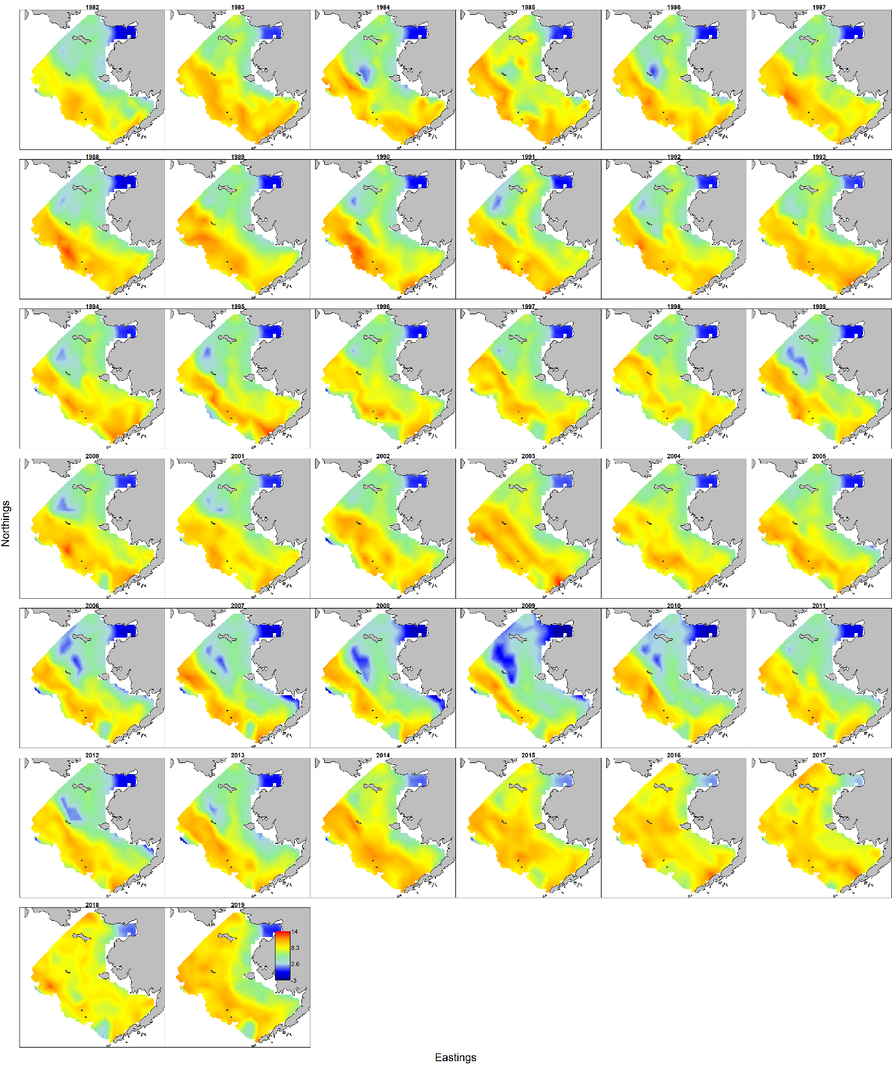
Walleye pollock density in Eastern Bering Sea
(ln kg. per square km.)

Slide 7
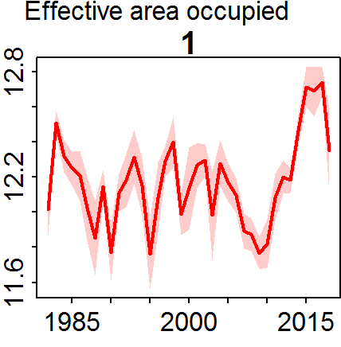
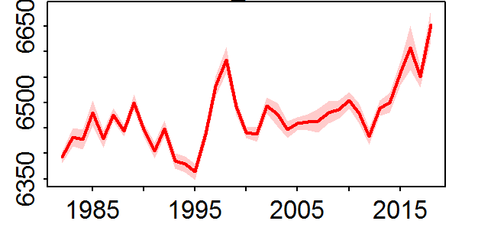
Combining multiple surveys
Conclusions
Has moved >300 km north from 1995-2018
Nearly 200 km north from 2012-2018
Increase 250% in area occupied since 2010
Natural log of square-kilometers
Northward center of gravity (km)
Notes:
Showing the proportion in the EBS (i.e., EBS biomass / EBS+NBS biomass) for models with or without temperature. The two are similar, although I think its 1998 where there’s some difference (adding temperature leads to lower estimates in NBS) and again in 2016 (where including temperature leads to higher estimates of NBS biomass)

Slide 8
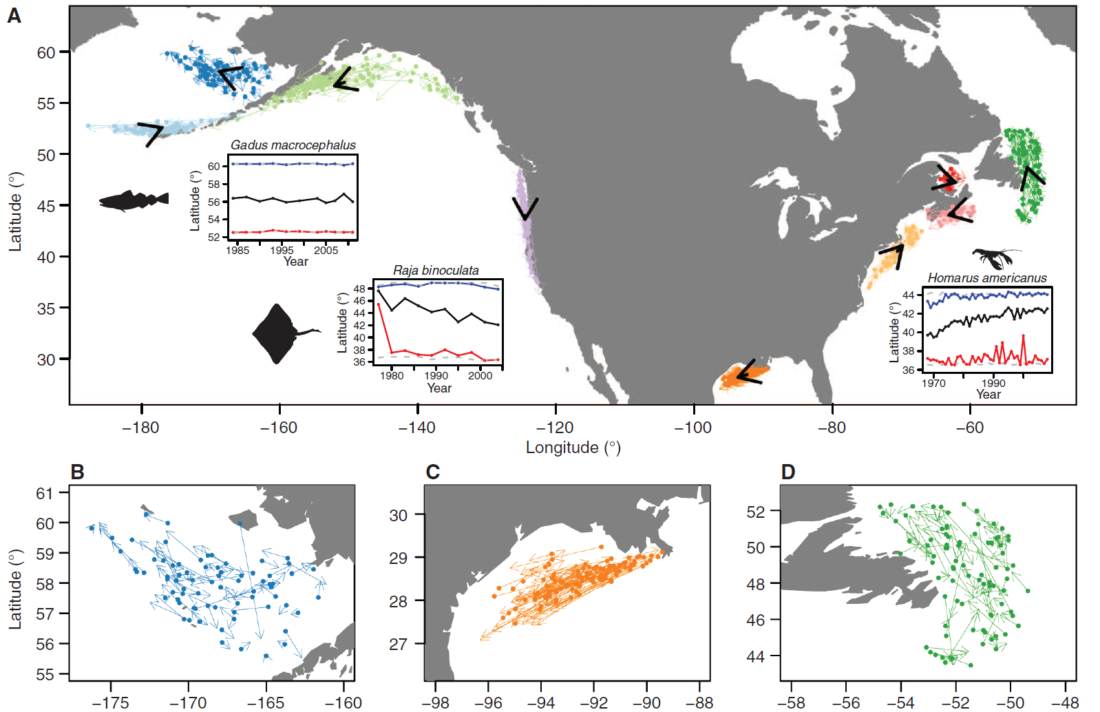
Pinsky et al. 2013 Science “Marine taxa track local climate velocity”

Slide 9
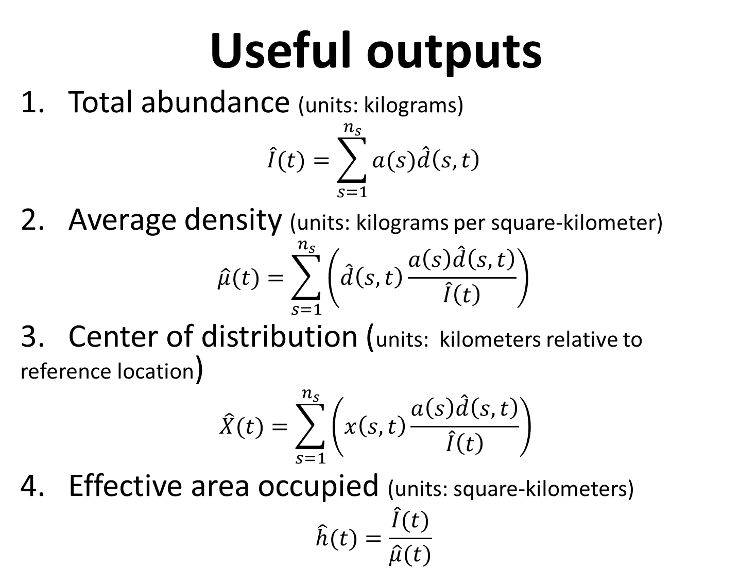
Useful outputs
1. Total abundance (units: kilograms)
$$\hat{I}(t)=\sum_{s=1}^{n_{s}}{a(s)\hat{d}\left(s,t\right)}$$
2. Average density (units: kilograms per square-kilometer)
$$\hat{μ}(t)=\sum_{s=1}^{n_{s}}{\left(\hat{d}\left(s,t\right)\frac{a\left(s\right)\hat{d}\left(s,t\right)}{\hat{I}\left(t\right)}\right)}$$
3. Center of distribution (units: kilometers relative to reference location)
$$\hat{X}(t)=\sum_{s=1}^{n_{s}}{\left(x\left(s,t\right)\frac{a\left(s\right)\hat{d}\left(s,t\right)}{\hat{I}\left(t\right)}\right)}$$
4. Effective area occupied (units: square-kilometers)
$$\hat{h}(t)=\frac{\hat{I}(t)}{\hat{μ}(t)}$$

Slide 10
Useful outputs
*** All metrics can be calculated for individual size/age/sex categories ***
Indicator name | Measurement of…
Total abundance | Population trends
Average density | Density dependence
Center of distribution | Distribution shifts
Effective area occupied | Expansion / collapse
Range edges | Colonization / extirpation
Subarea abundance | Availability to different ports
Correlation with other species | Assemblage and species-complex
Overlap metrics | Predation pressure
Local habitat effects | Preferred habitats
Regional habitat effects | Basin-scale environmental drivers of dynamics
Forecasts | Continuously bridge from annual → decadal → end-of-century predictions

Slide 11
Newer (non-standard) options
Indicator name | Measurement of…
Condition | Abundance-weighted condition (annual and spatial maps)
Size-at-age | Variation in realized growth
Stomach contents | Food availability
Bioenergetics | Comparing food demand and supply

Slide 12
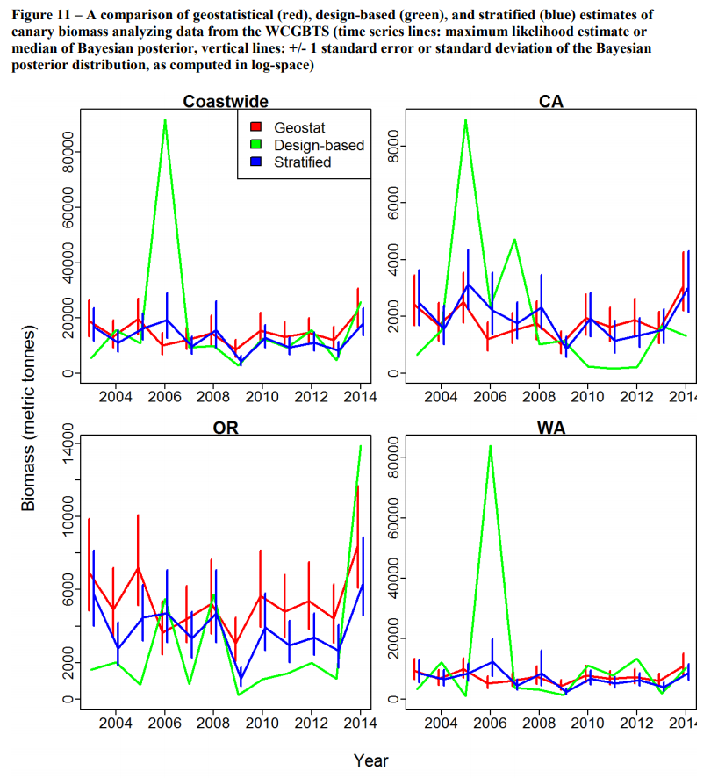
Justification
US West Coast Canary rockfish assessment
Thorson and Wetzel 2016
Single tow in WA 2016 results in 10-fold increase in design-based index for that year

Slide 13
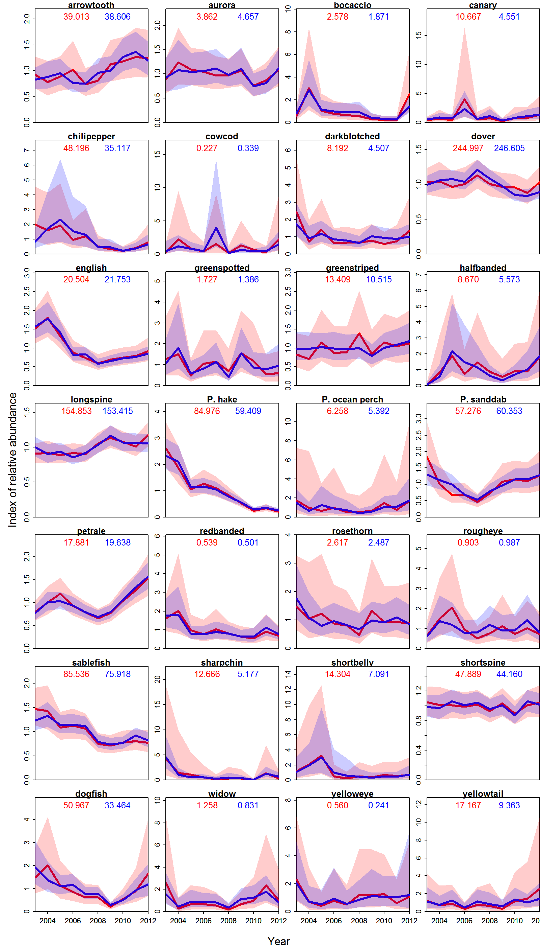
Abundance indices
Relative abundance
Conventional
Geostatistical

Slide 14
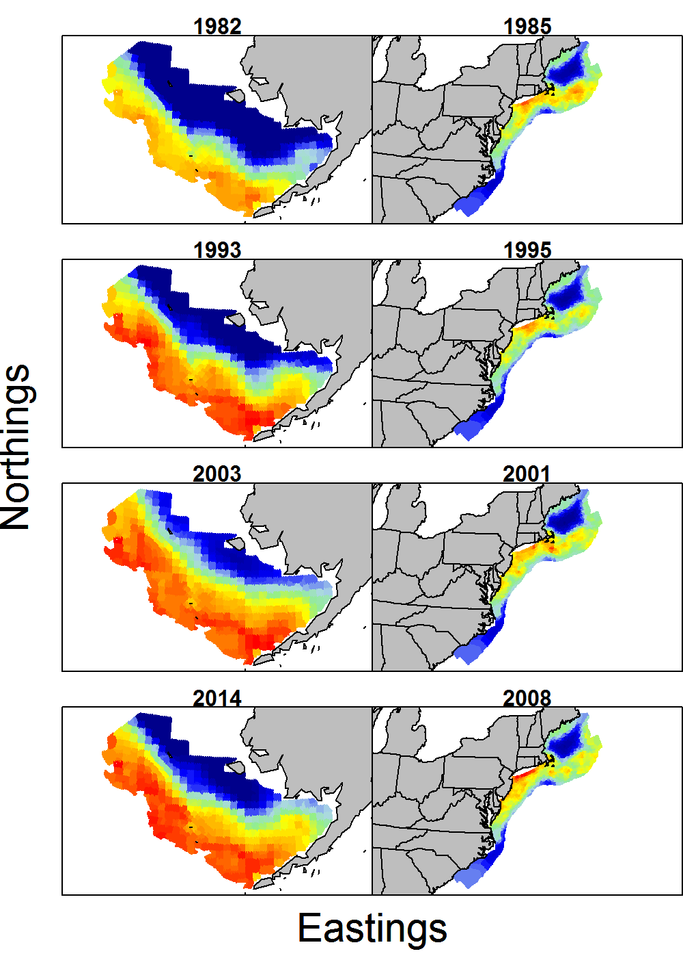
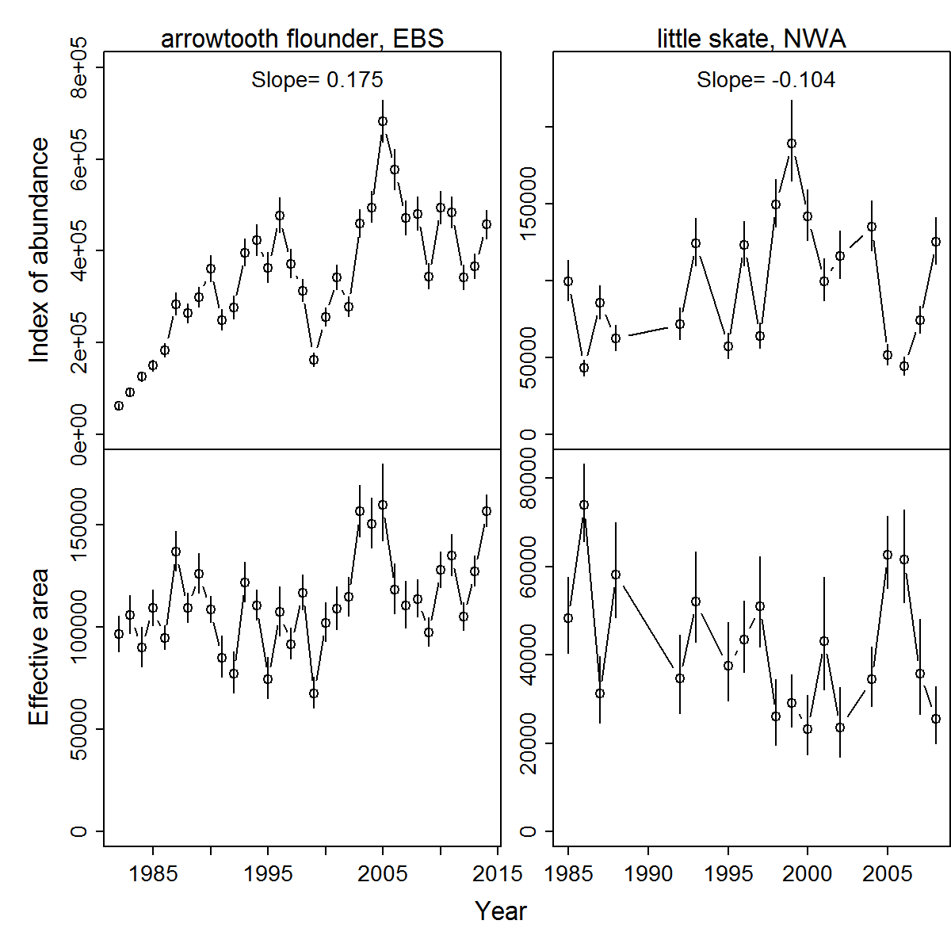
Arrowtooth flounder
Eastern Bering Sea
Arrowtooth flounder
EBS
Density-dependent habitat selection
Do populations shrink their range when abundance is low?
Average
Small contraction in range
Greatest in Eastern Bering Sea
Effective area Index of abundance
Year
Thorson, Rindorf, Gao, Hanselman, and Winker. 2016. Density-dependent changes in effective area occupied for sea-bottom-associated marine fishes. Proc R Soc B 283(1840).

Slide 15
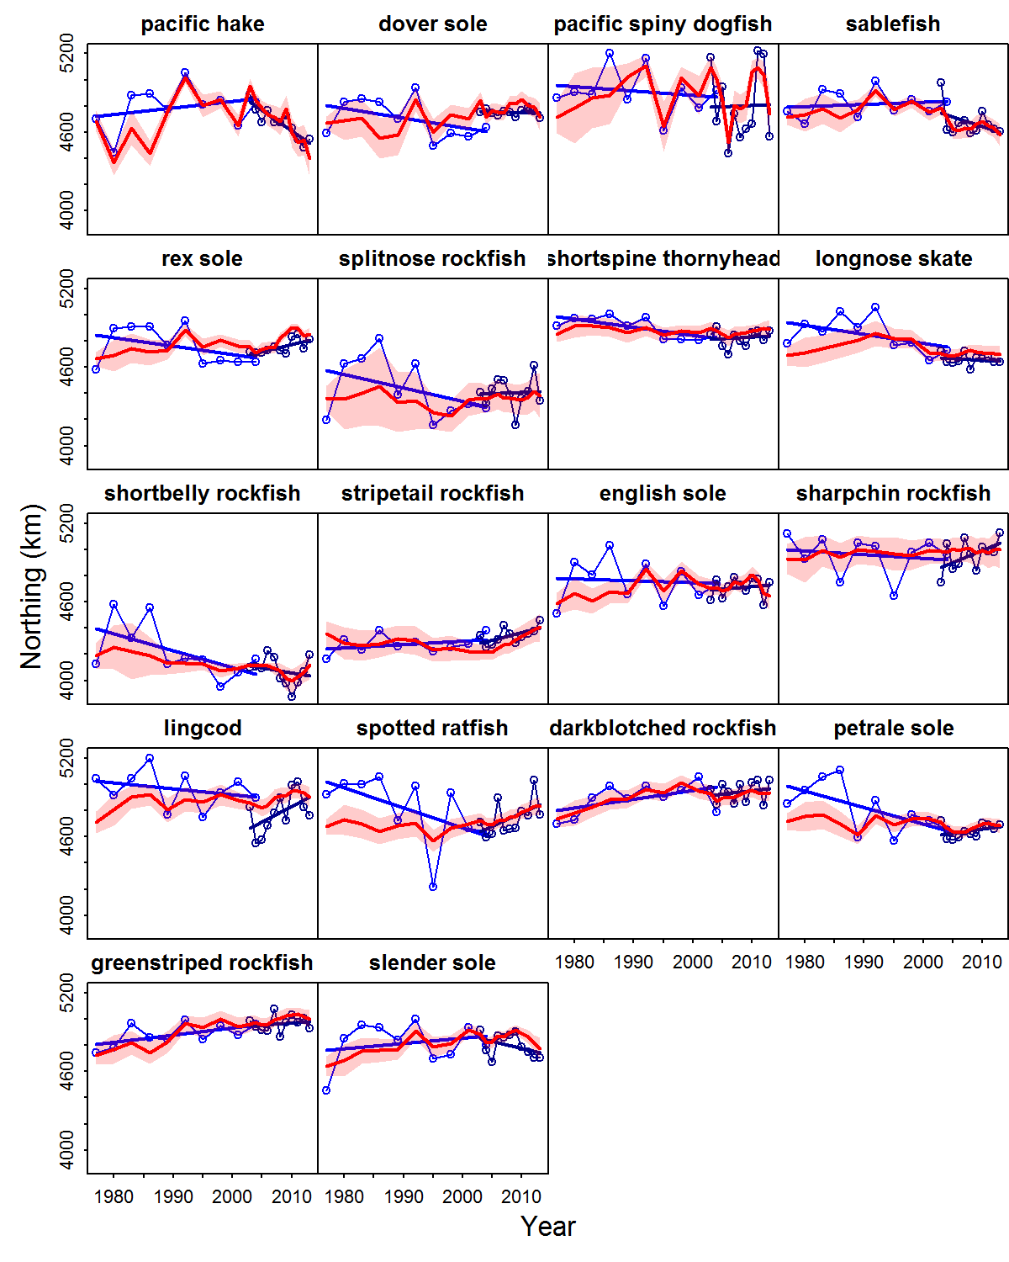
Distribution shifts
Highly variable distribution for semi-pelagic species
Dogfish
Sablefish
Hake
Few clear trends
Depends on time-scale
Thorson, Pinsky, and Ward. 2016. Model-based inference for estimating shifts in species distribution, area occupied and centre of gravity. Methods Ecol. Evol. 7(8): 990–1002.
Model-based
Abundance-weighted average

Slide 16
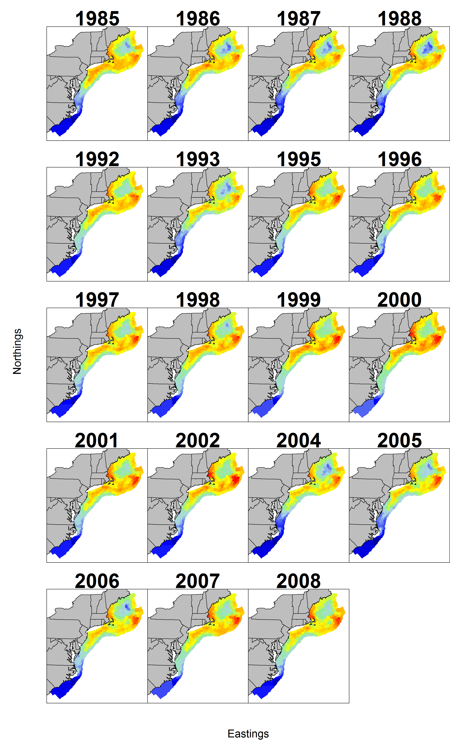
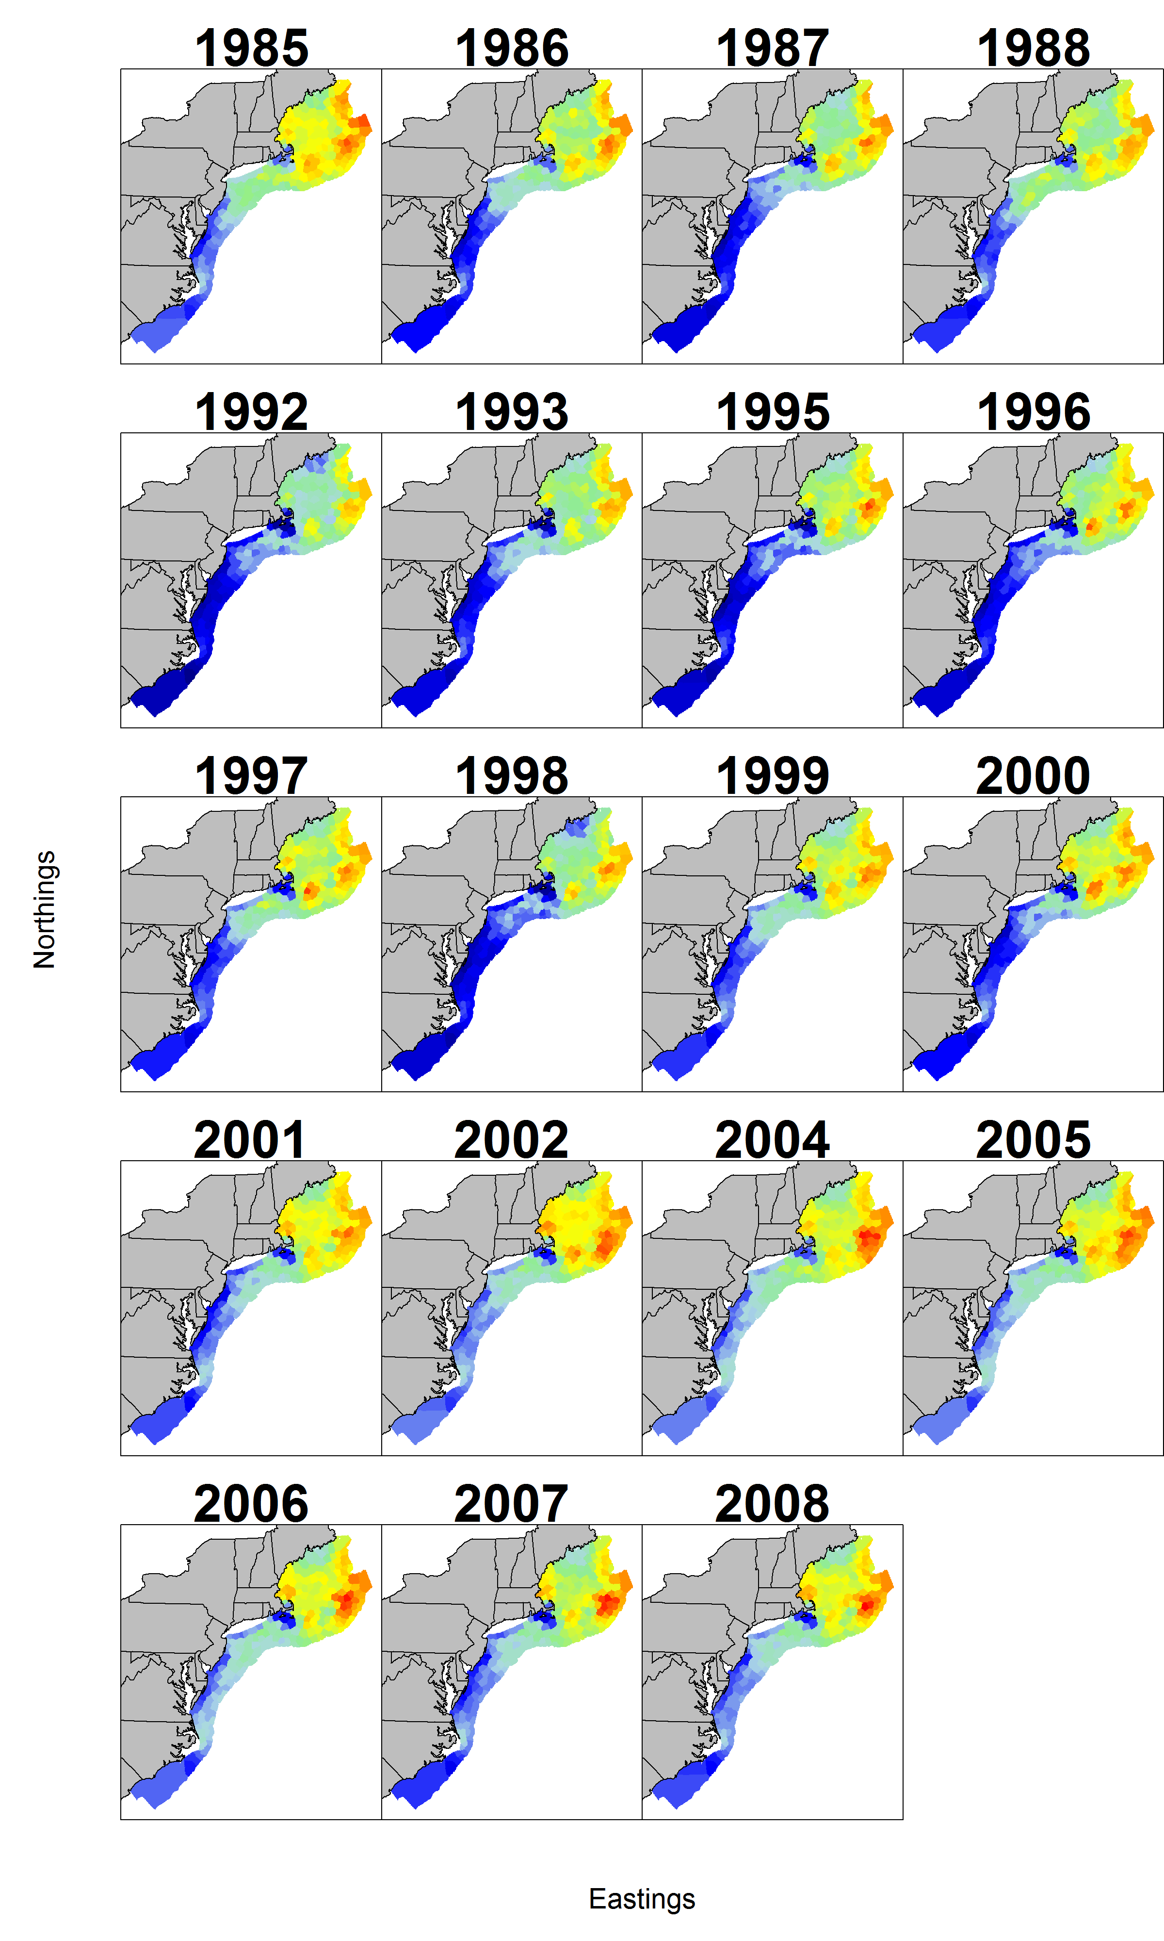
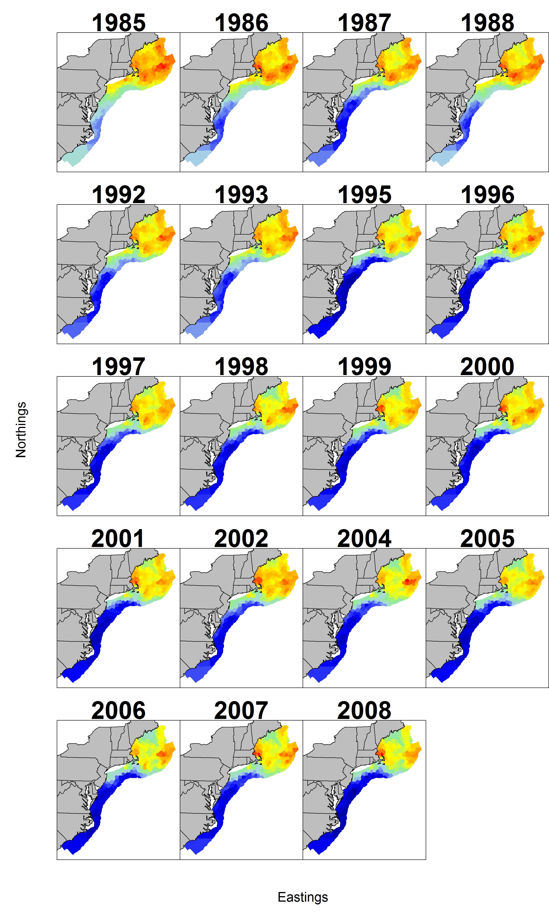
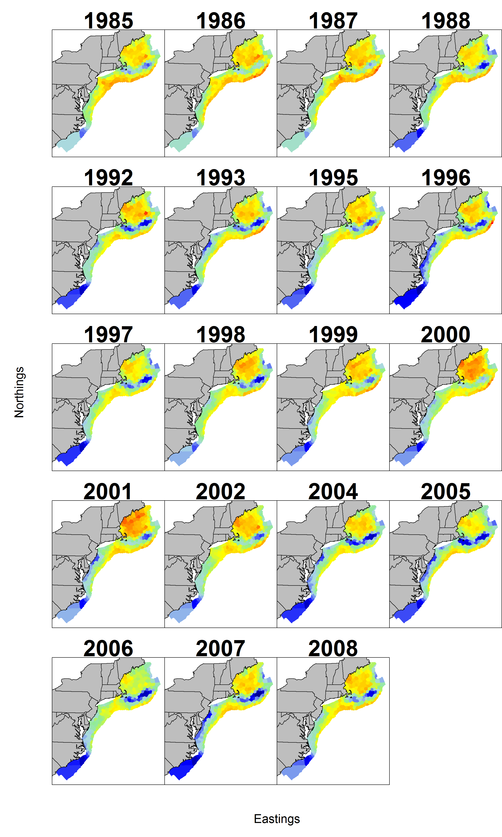
Joint species distribution models
Yellowtail flounder
Haddock
Atlantic cod
Silver hake

Slide 17
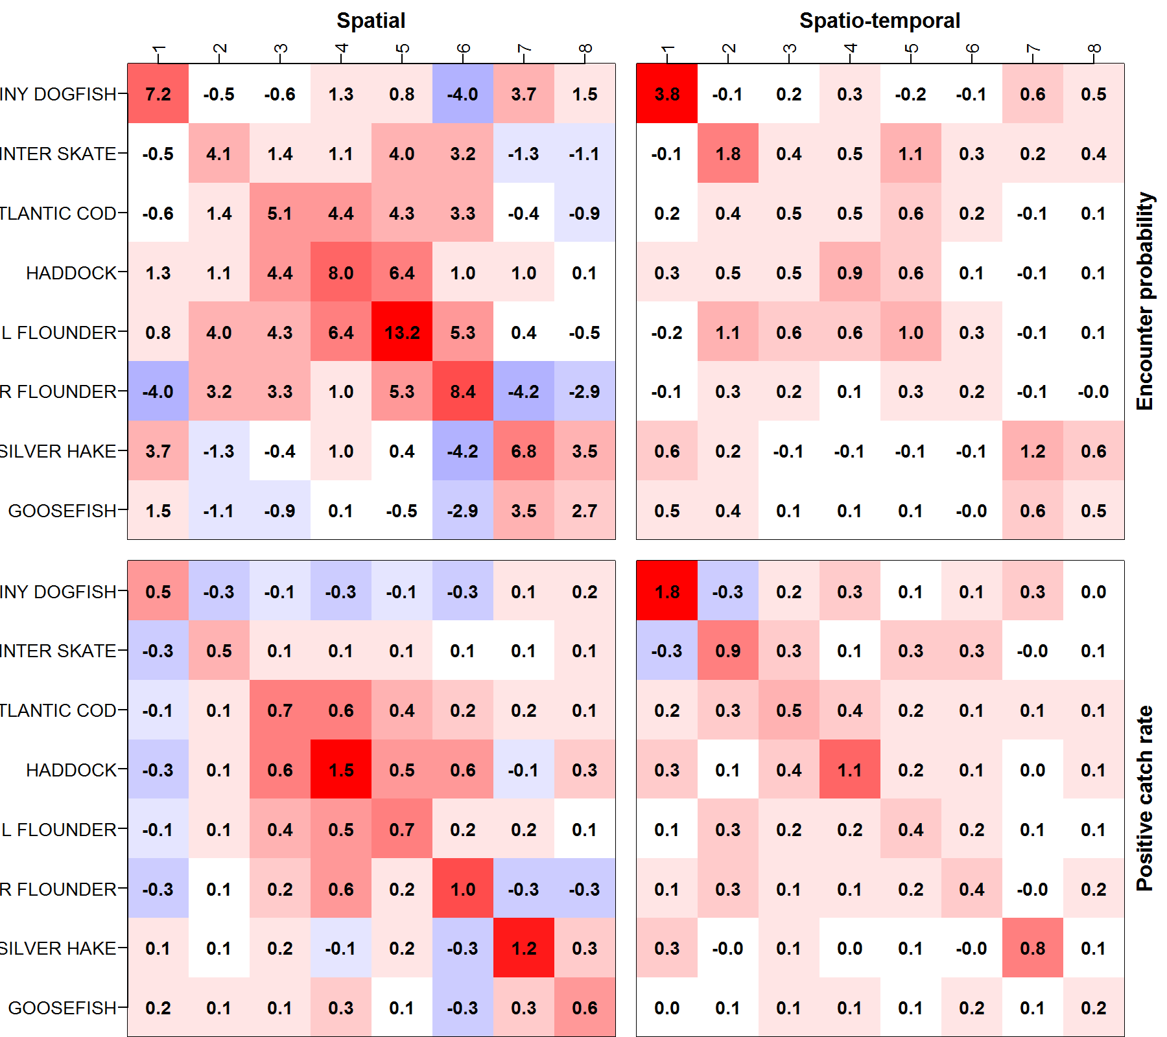

Slide 18
Combining surveys using VAST
Paper | Region | Use
Thorson Pinsky Ward 2016 MEE | California Current | Combine triennial (1982-2004) and annual (2003-present) survey
O’Leary et al. 2022 ICESJMS | Eastern, western, and northern Bering Sea | Combine US historical and climate-adaptive surveys with Russian survey
Perretti and Thorson 2019 Fish. Res. | Northeast US | Combine offshore (NEFSC) and nearshore (NEAMAP) surveys
Gruss and Thorson 2019 ICESJMS | Gulf of Mexico | Combine various fishery-dependent and –independent data
Maureaud et al. 2021 Global Change Biology | North Pacific | Combine US and Canada surveys
ICES Workshop on Survey Information for Celtic Sea Gadids | Celtic Sea | Combine French and Irish surveys to account for French survey disruption
Alglave et al. 2022 ICESJMS | Bay of Biscay | Combine fishery and survey data
Astarloa et al. 2021 Frontiers in Marine Science | Bay of Biscay | Combine various surveys for common dolphin distribution
Gruss et al. 2020 Fish & Fish | Eastern Bering Sea | Combine predator diet and density sampling to estimate diet proportions
Gruss et al. 2023 CJFAS | Eastern Bering Sea | Combine predator diets and industry cooperative survey to get forage index

Slide 19
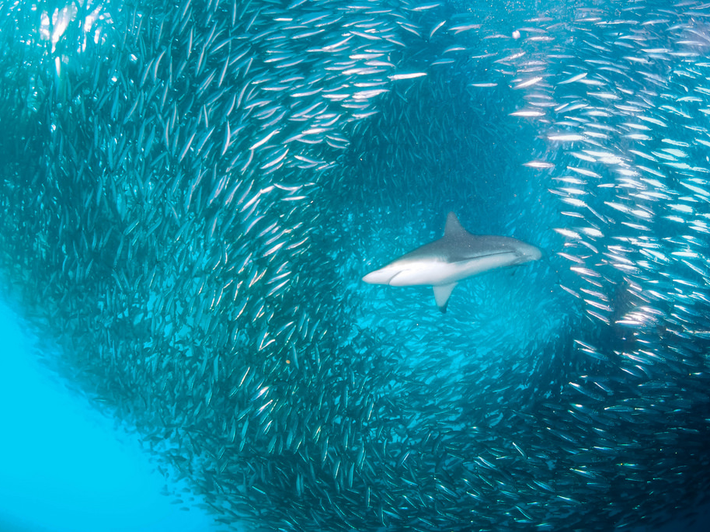
Joint species distribution models

Slide 20
Joint species distribution models
Many operational versions
Hierarchical Modelling of Species Communities (HMSC)
Ovaskainen et al. 2017
Generalized joint attribute model (GJAM)
Clark et al. 2017
Vector autoregressive spatio-temporal model (VAST)
Thorson and Barnett 2017
Finite Mixture of Regression Models (FMR)
Dunstun, Foster and Darnell 2011

Slide 21
Several multivariate models available in VAST
Model | Size of model | Varies over time? | Correlated among species? | Includes species interactions? | Correlated over time? | dynamics are correlated locally?
Spatial factor analysis | Small | No | Yes | No | NA (no time) | No
Multivariate index standardization | Medium | Yes | No | No | No | No
Empirical orthogonal function analysis | Medium | Yes | No | No | Yes | Yes
Spatial dynamic factor analysis | Large | Yes | Yes | No | No | No
Spatial models of intermediate complexity for ecosystems | Very large | Yes | Yes | Yes | Yes | No
Joint demographic models | Varies among applications

Slide 22
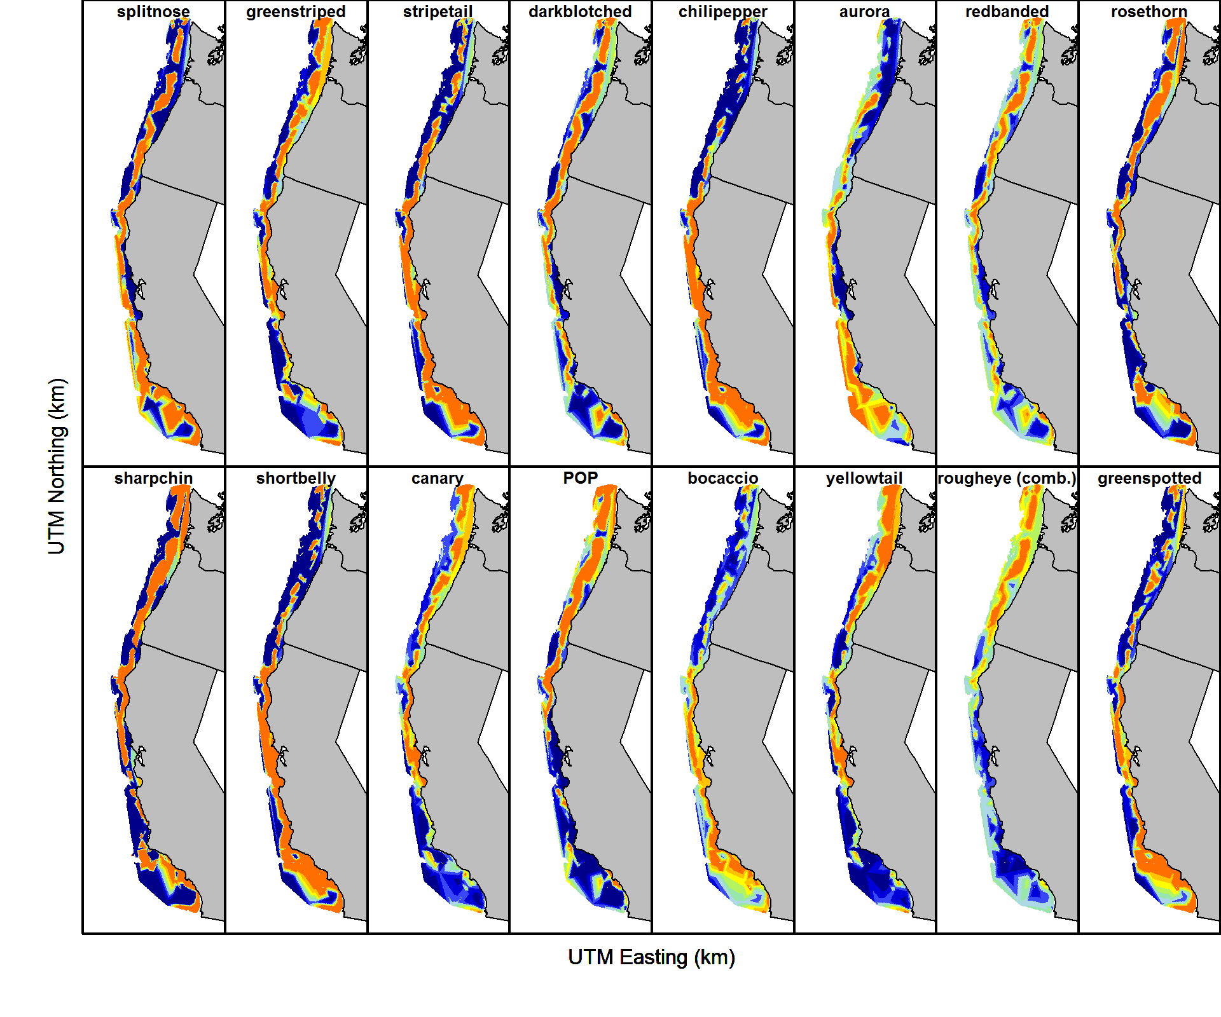
Spatial factor analysis
Thorson, Scheuerell, Shelton, See, Skaug, & Kristensen. (2015). Spatial factor analysis: a new tool for estimating joint species distributions and correlations in species range. Methods in Ecology and Evolution, 6(6), 627–637. https://doi.org/10.1111/2041-210X.12359

Slide 23
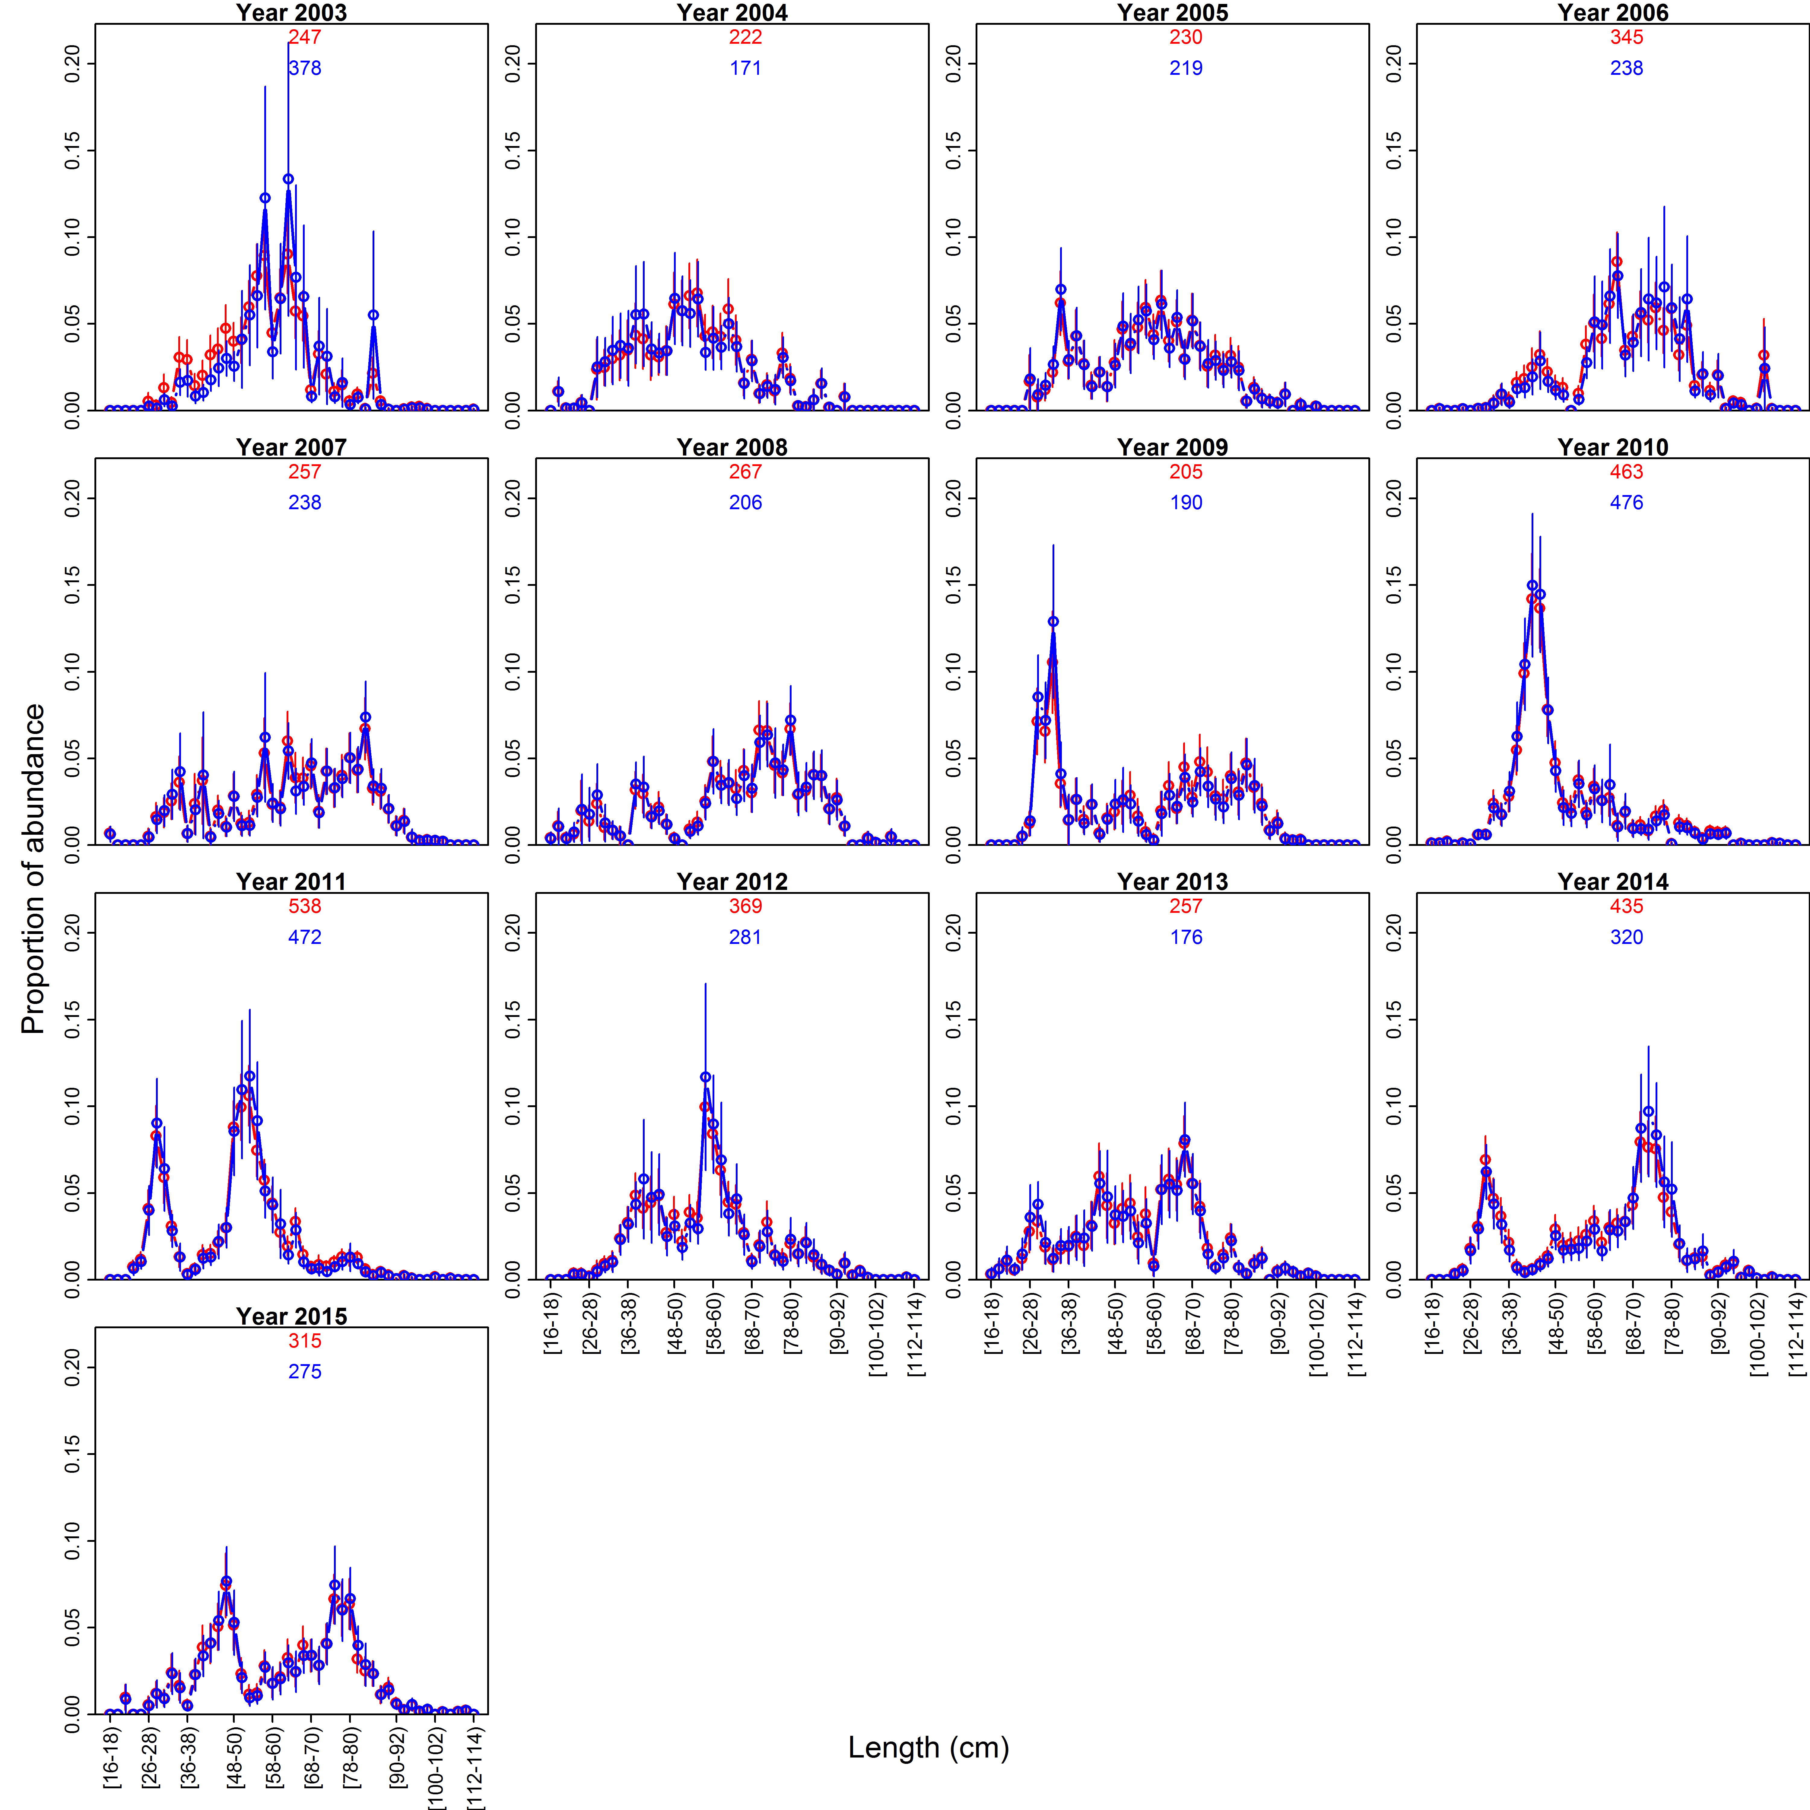
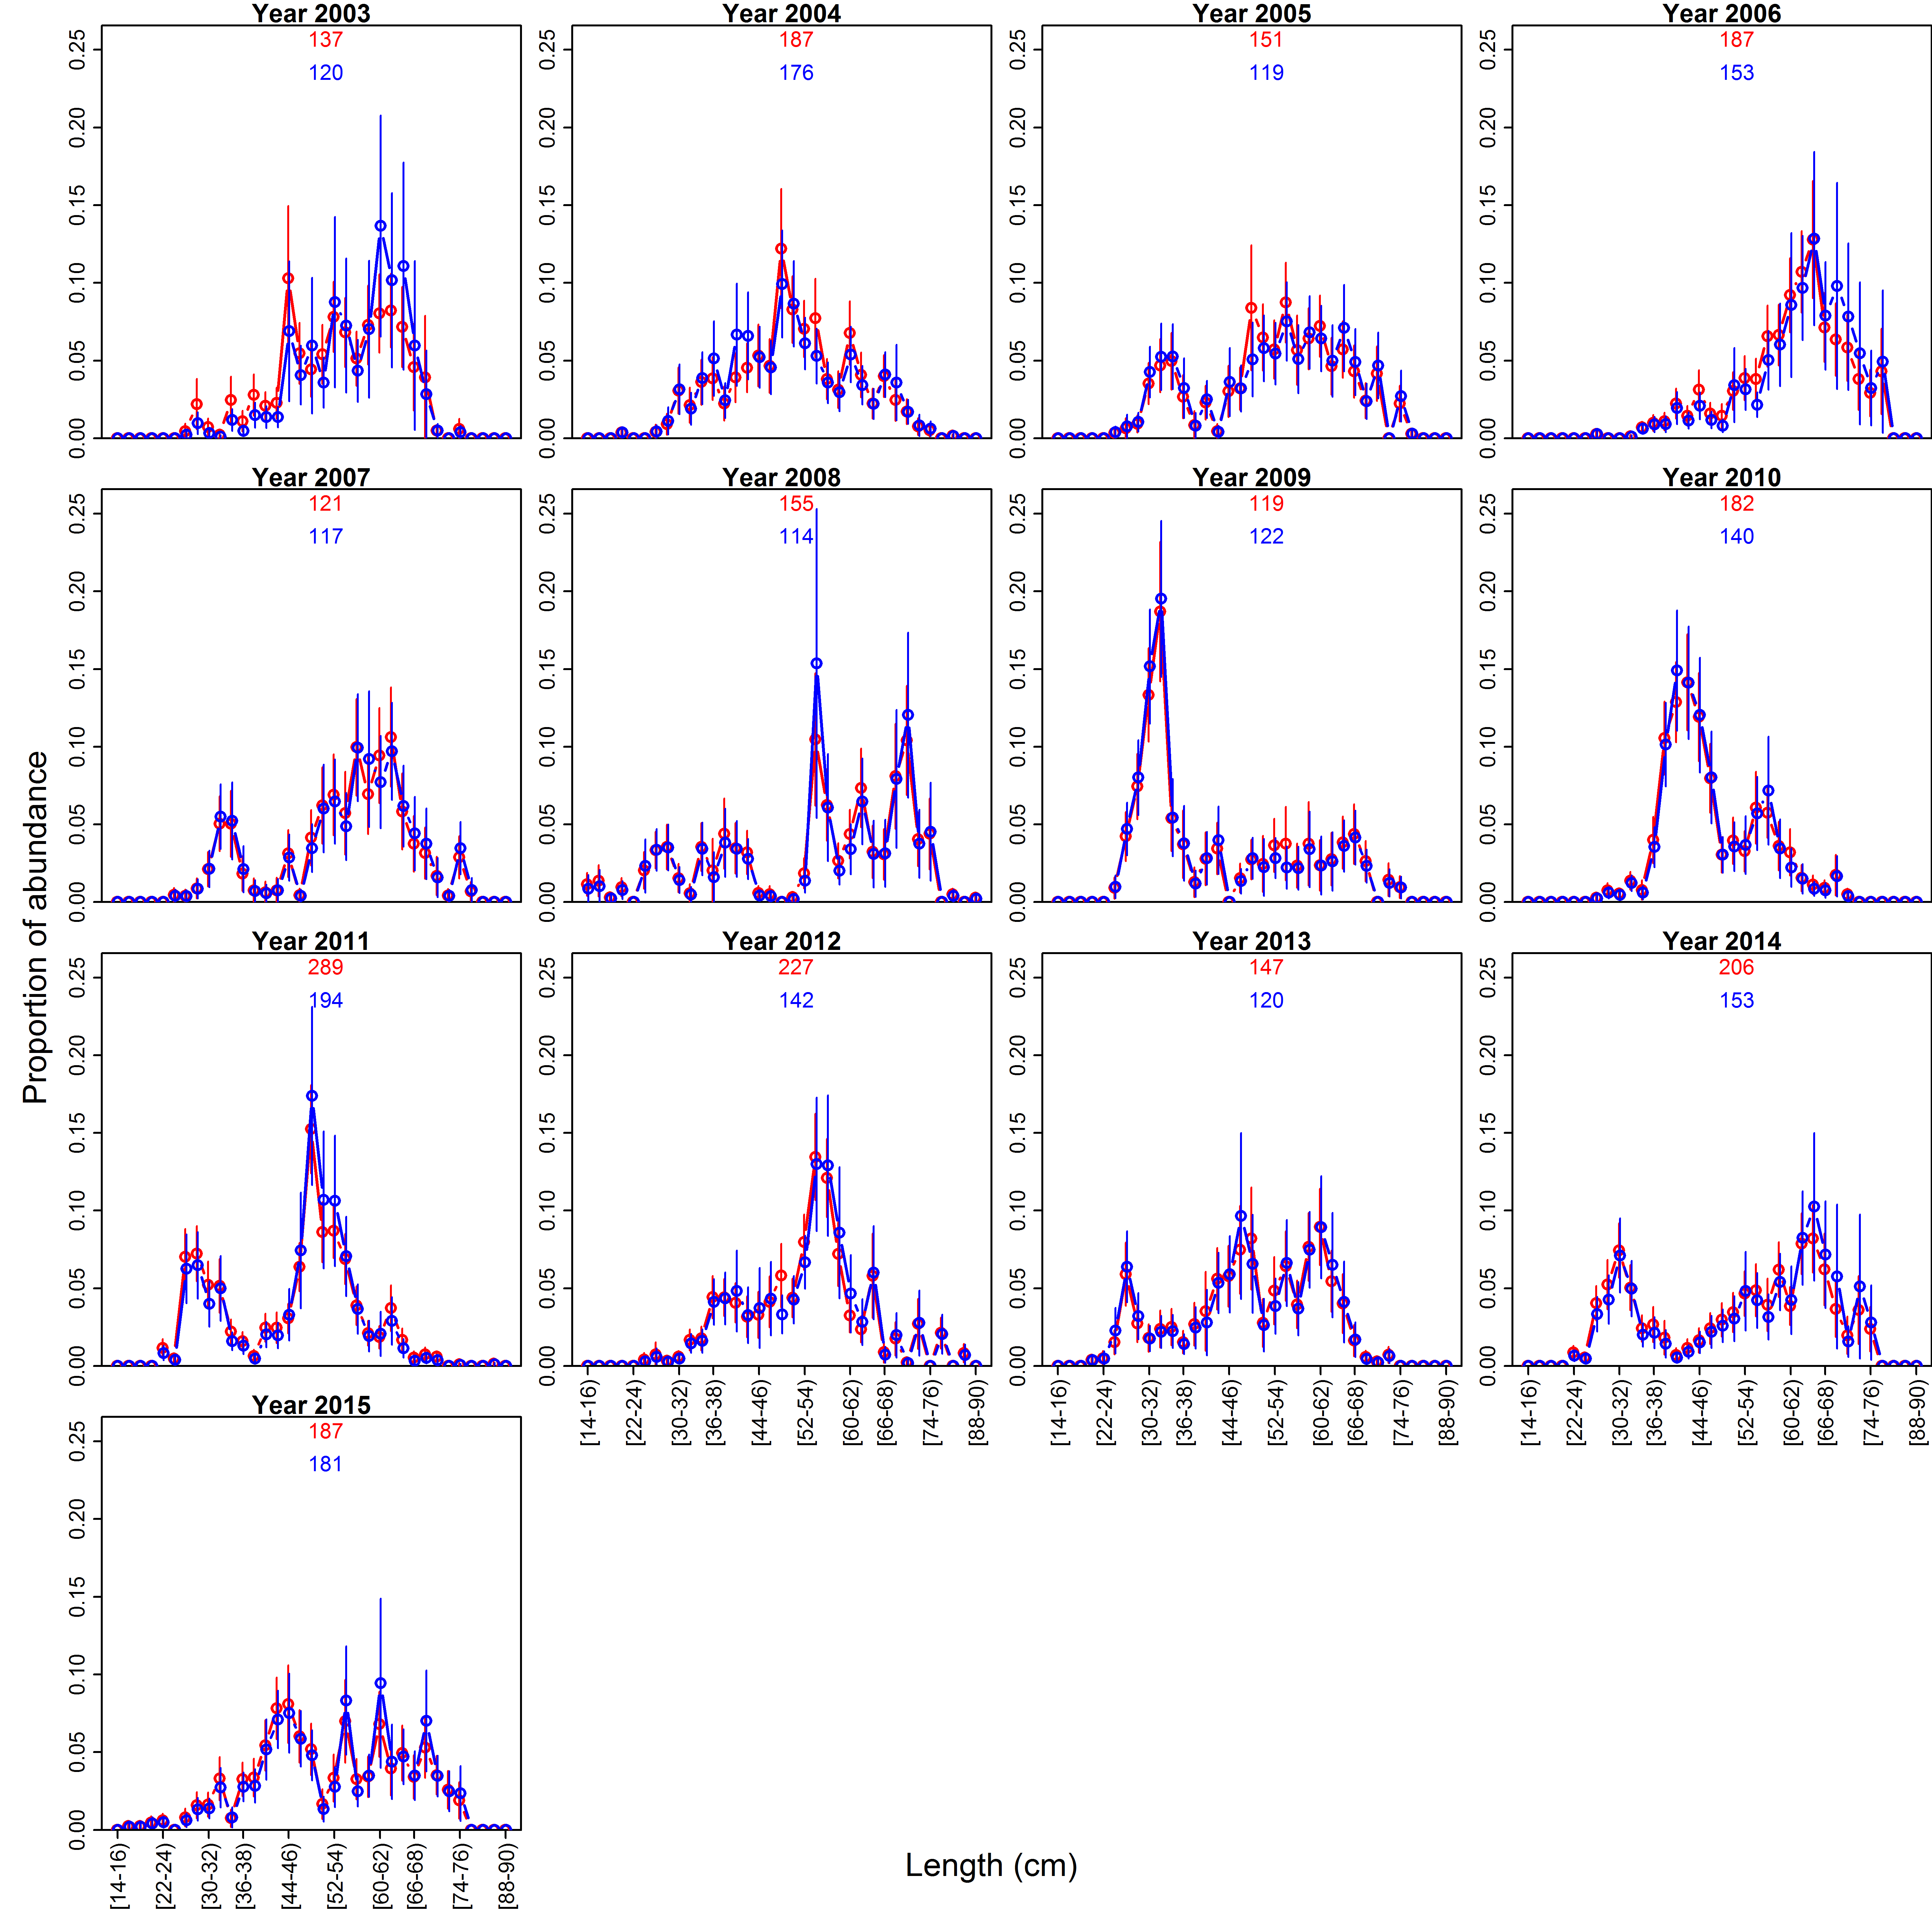
Multivariate index standardization
Lingcod case-study application
Female proportions
Male proportions
Design-based
Spatio-temporal

Slide 24
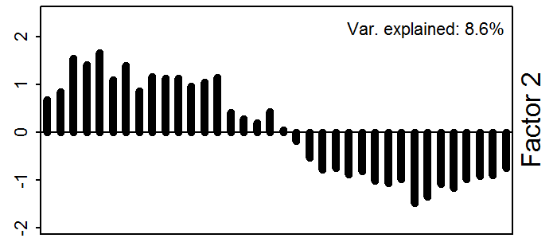
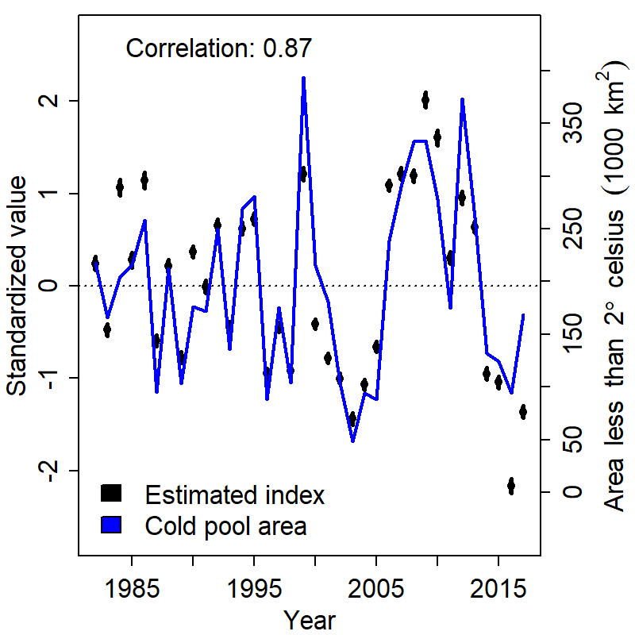
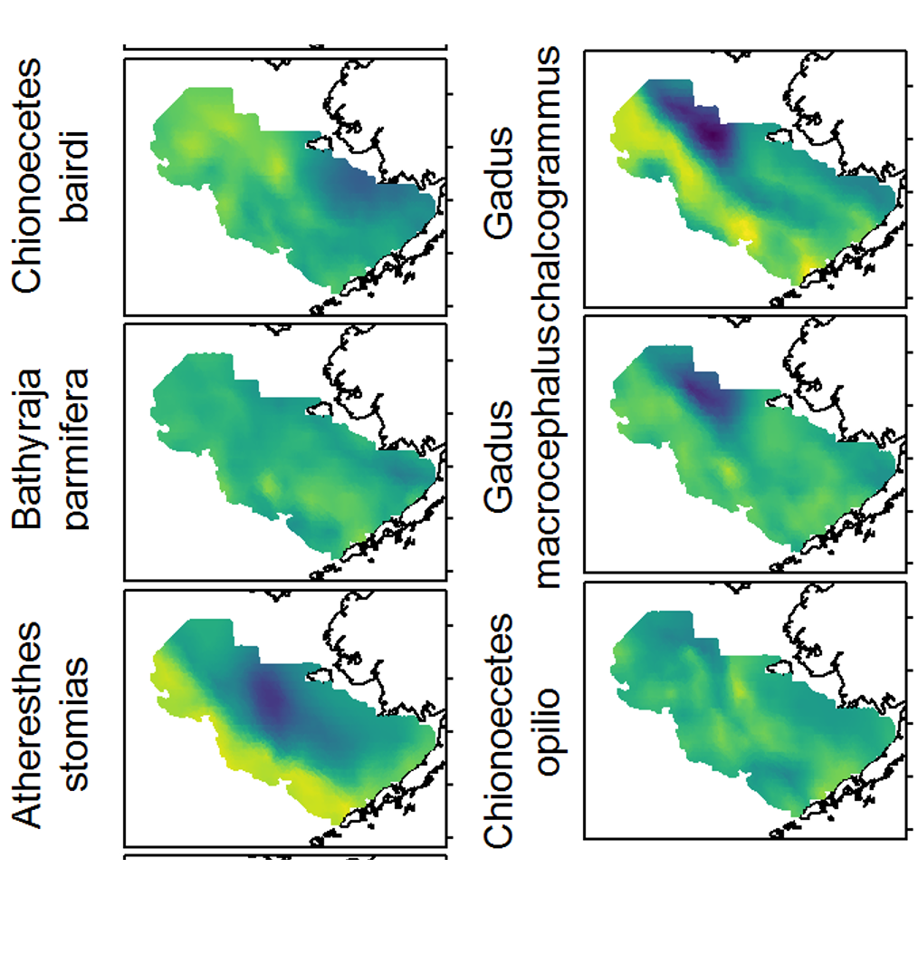
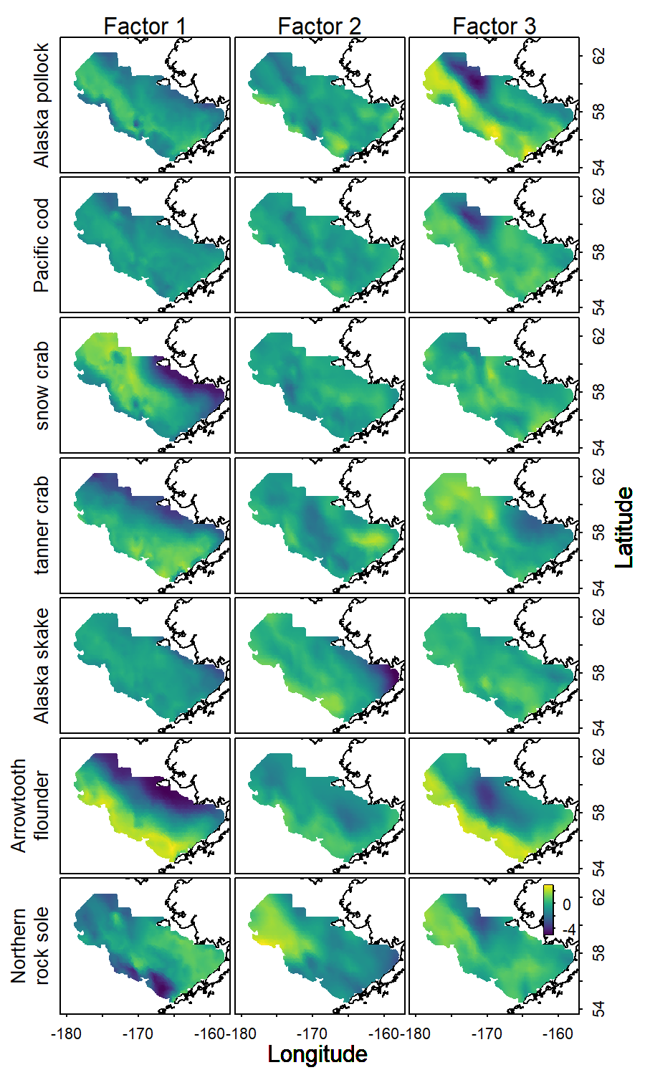
Empirical Orthogonal Function analysis
Factor 2: Long-term trends
Factor 3: Cold pool
Cold pool area
Biological index

Slide 25
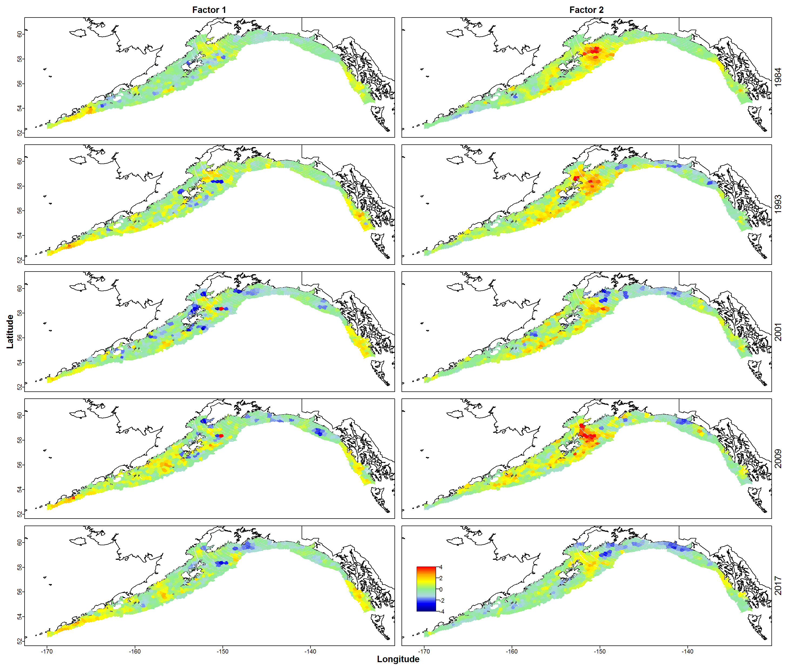
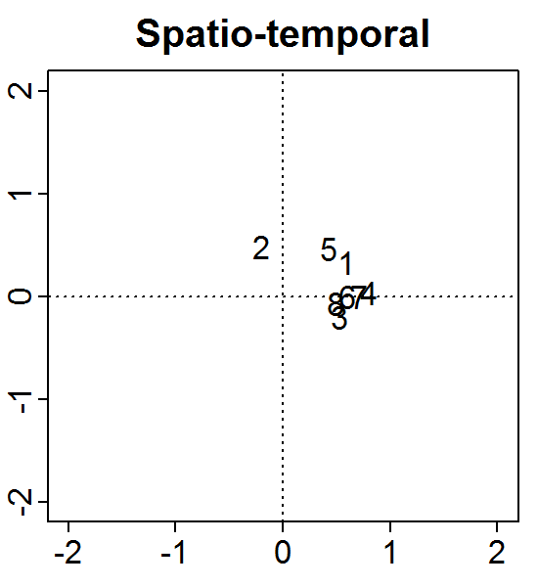
Spatial dynamic factor analysis
1: Atheresthes stomias, arrowtooth flounder;
2: Hippoglossus stenolepis, Pacific halibut;
3: Gadus chalcogrammus, Walleye pollock;
4: Glyptocephalus zachirus, rex sole;
5: Gadus microcephalus, Pacific cod;
6: Hippoglossoides elassodon, flathead sole;
7: Microstomus pacificus, Dover sole;
8: Anoplopoma fimbria, sablefish
Groundfish in Gulf of AK
Association of each species with each factor
Factor 2
Factor 1

Slide 26
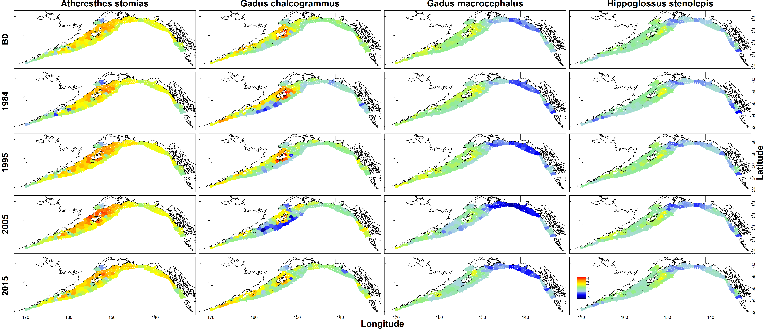
Spatial models of intermediate Complexity for Ecosystems
Unfished population density
Annual variation in density

Slide 27
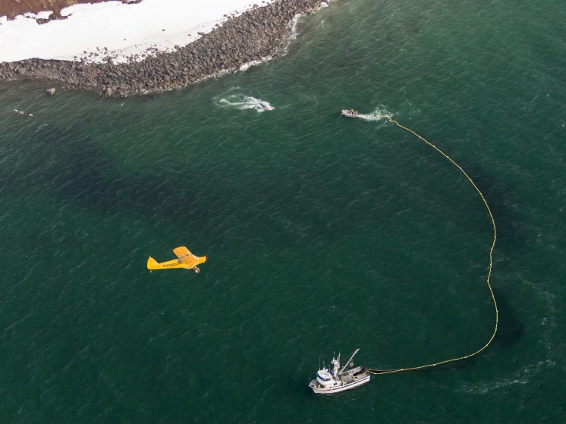
Spatial correlations

Slide 28
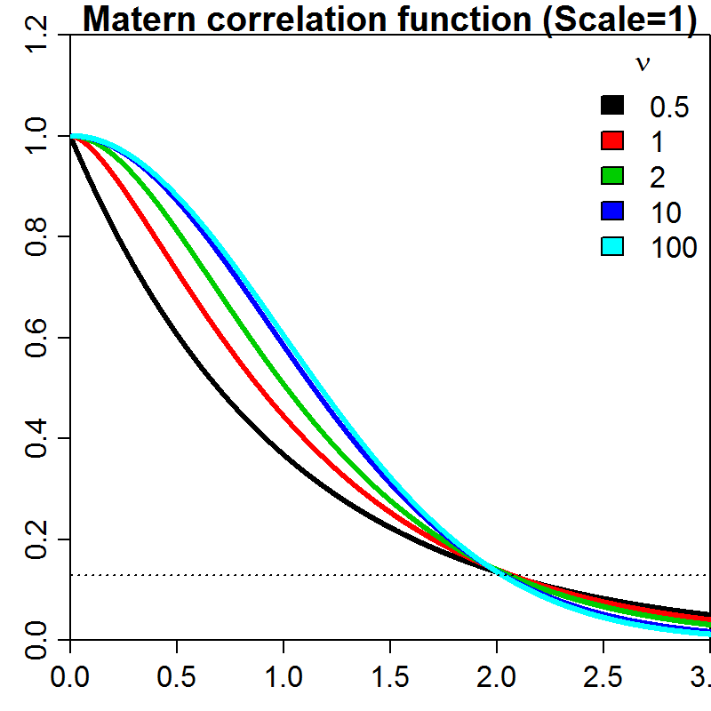
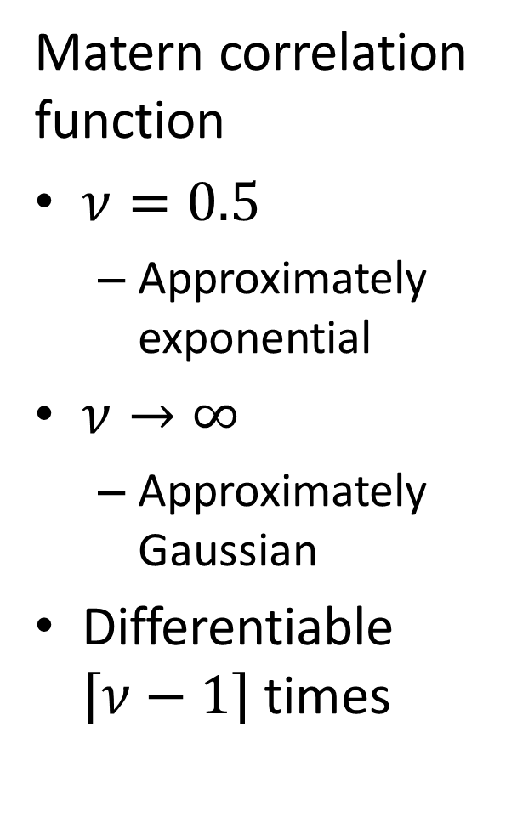
Spatial Correlation
Matern correlation function
$ν=0.5$
Approximately exponential
$ν→∞$
Approximately Gaussian
Differentiable $\left\lceil ν−1\right\rceil$ times

Slide 29
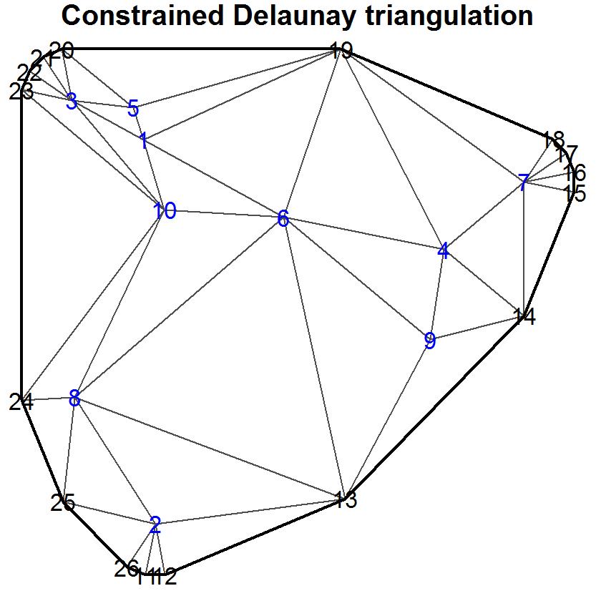
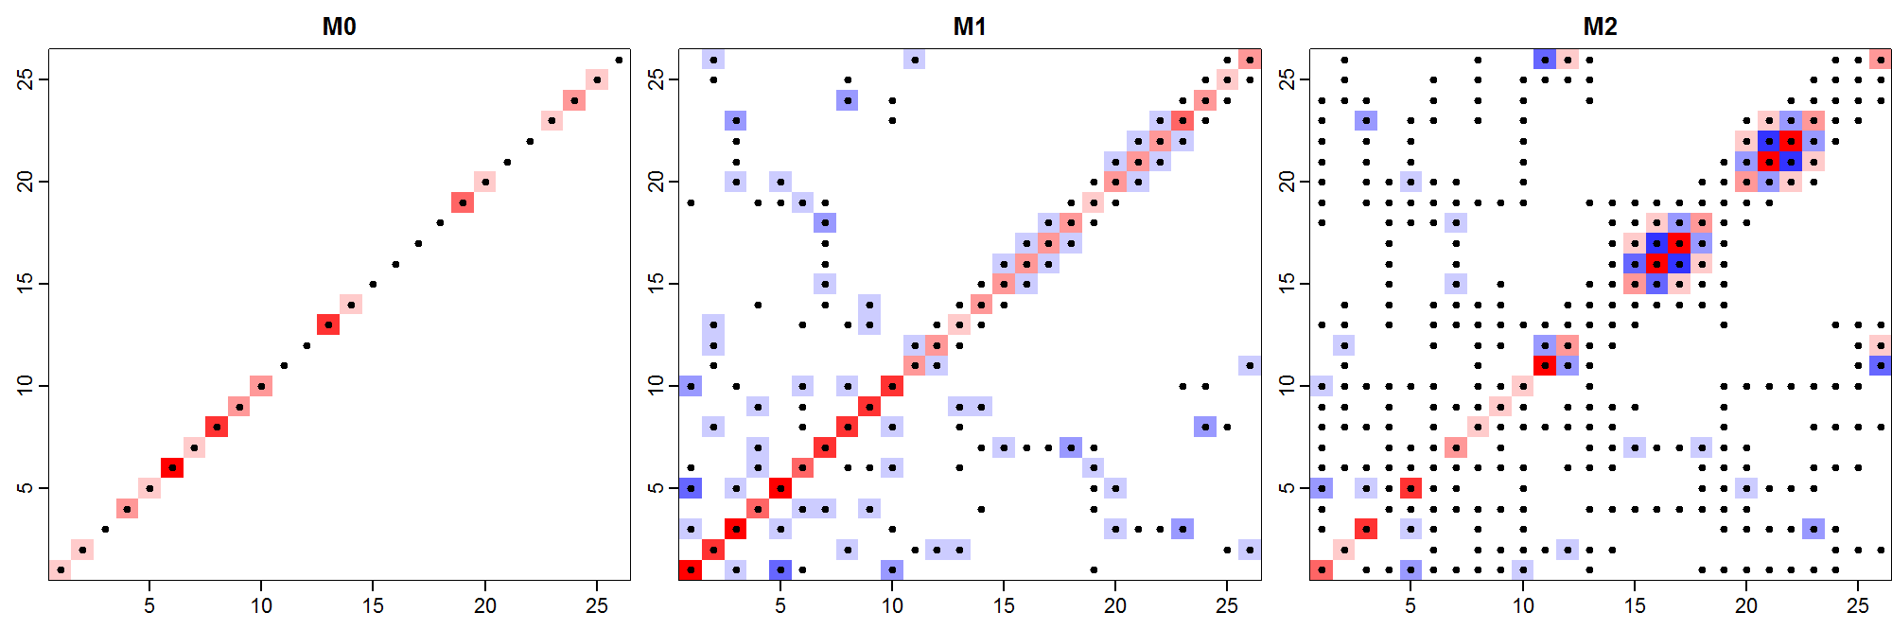
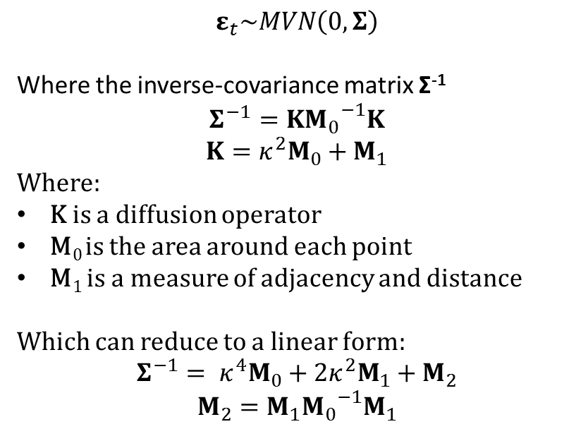
$$ε_{t}\sim MVN\left(0,Σ\right)$$
Where the inverse-covariance matrix Σ⁻¹
$$Σ^{−1}=K{M_{0}}^{−1}K$$
$$K=κ^{2}M_{0}+M_{1}$$
Where:
K is a diffusion operator
M₀ is the area around each point
M₁ is a measure of adjacency and distance
Which can reduce to a linear form:
$${Σ^{−1}= κ}^{4}M_{0}+2κ^{2}M_{1}+M_{2}$$
$$M_{2}=M_{1}{M_{0}}^{−1}M_{1}$$

Slide 30
Spatial Correlation
Sparse spatial correlation matrices
SPDE approximation
2D autoregressive process
Stream network as Ornstein-Uhlenbeck process
Parameter estimation
Maximum marginal likelihood
Can use “bias-correction” for empirical Bayes predictions
Template Model Builder
Automatic differentiation
Laplace approximation

